Slide 1

Unit 4

Slide 2

Brand Performance Metrics
Awareness
Familiarity
Consideration
Advocacy

Slide 3

Brand Performance Metric 1: Measuring Brand Awareness
It tells if people even know your brand or can recall it with a quick prompt.
Top-of-mind brand awareness
Unaided brand awareness
Aided brand awareness

Slide 4
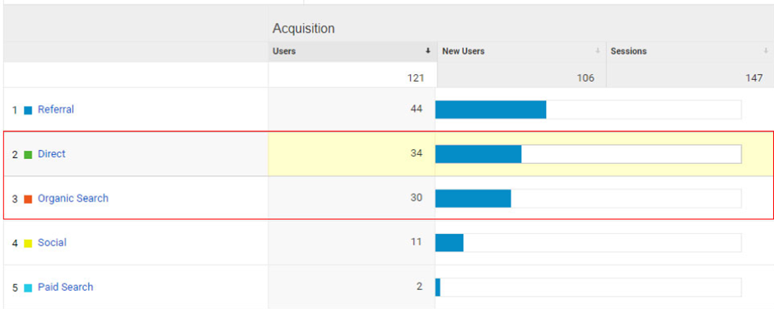

Slide 5

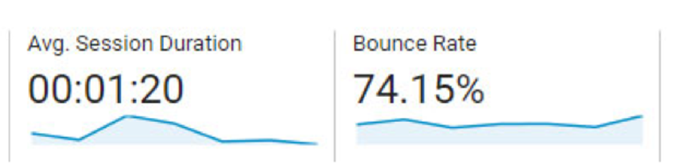
Brand Performance Metric 2: Familiarity
Self-declared knowledge about the brand
Brand profile

Slide 6
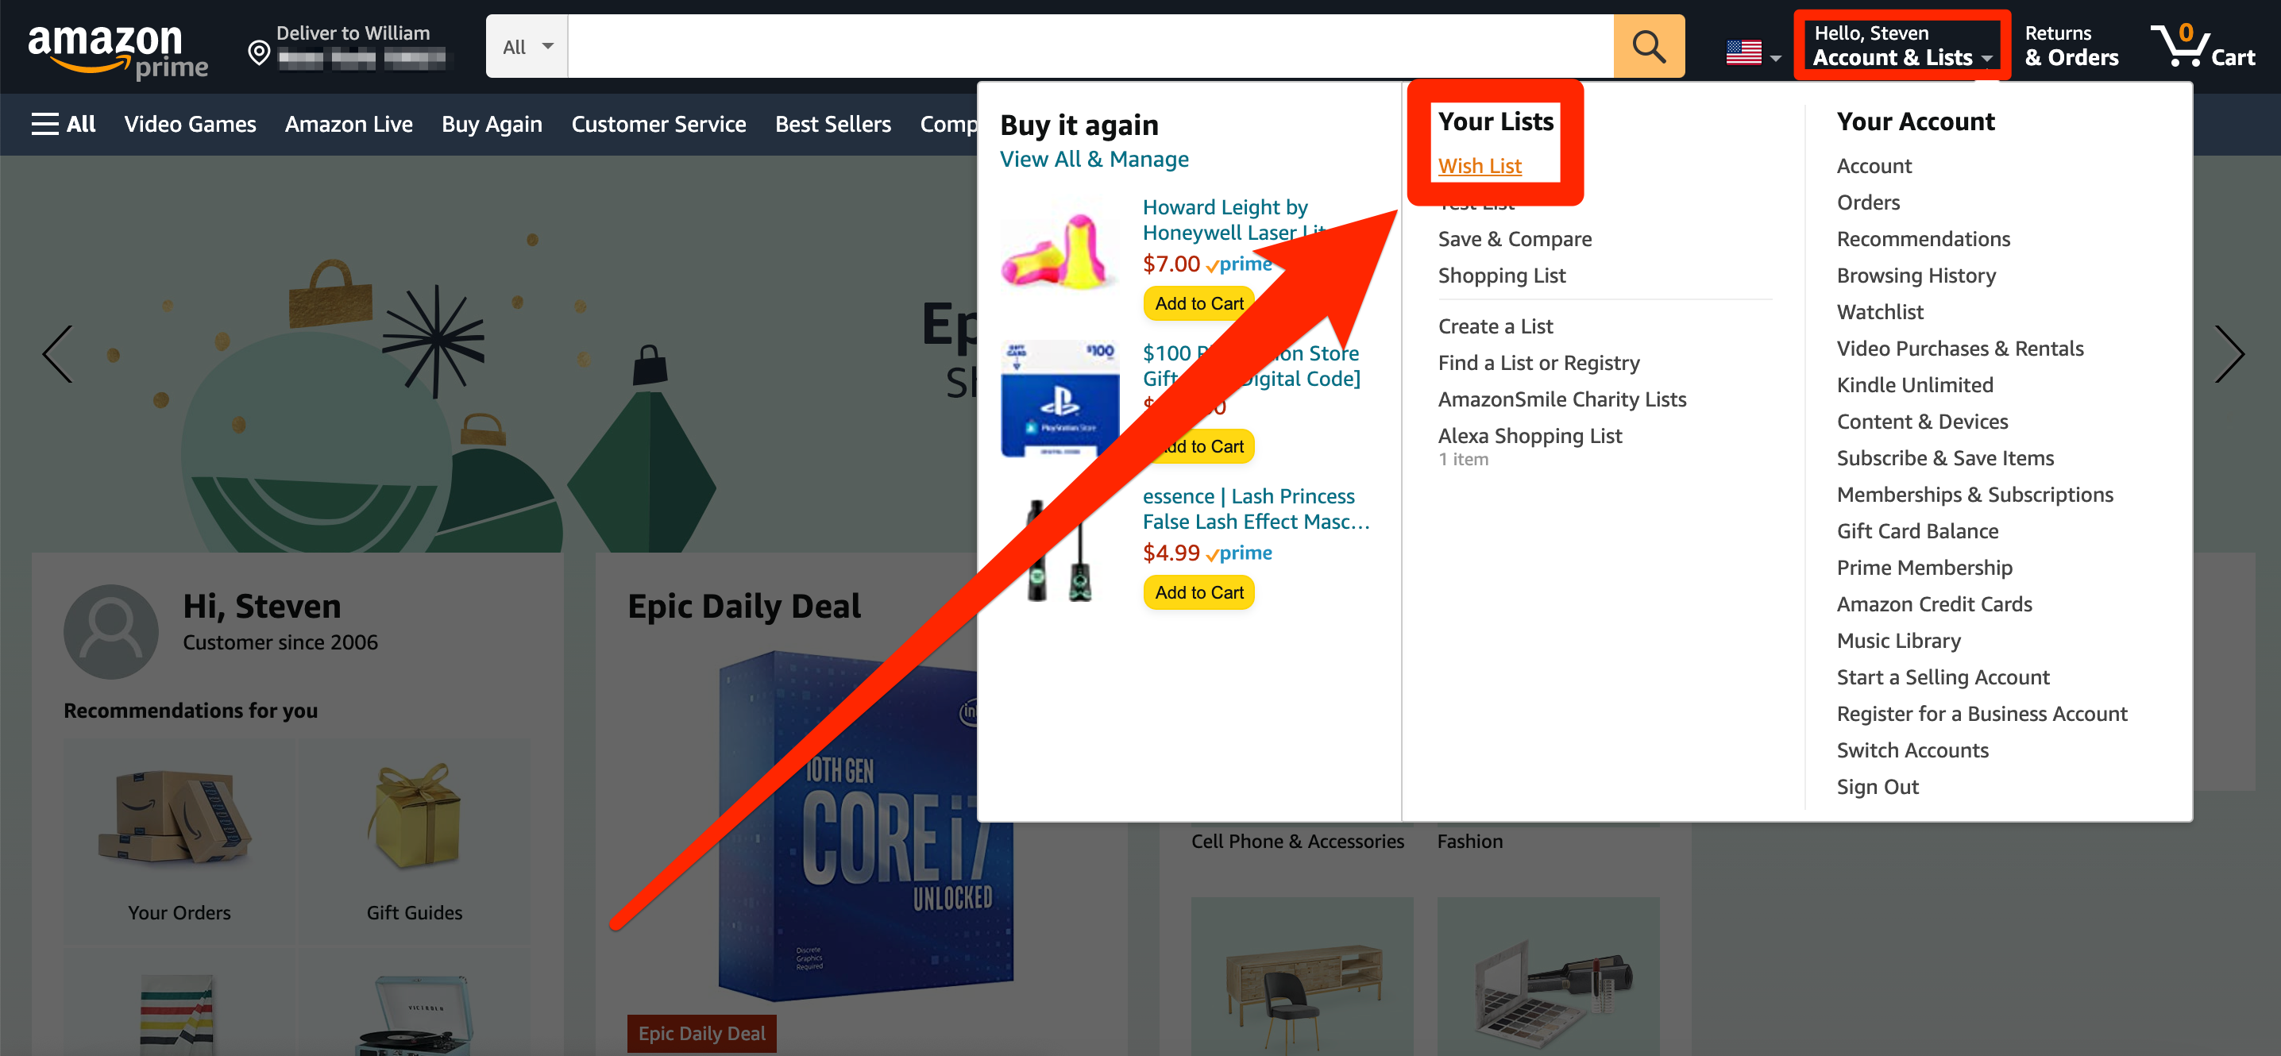
Brand Performance Metric 3: Consideration
Purchasing Intent

Slide 7

Brand Performance Metric 4: Advocacy
Net Promoter Score
Social mentions

Slide 8

Measuring Sources of Brand Equity
Capturing the response of customer in a basic questionnaire format
Qualitative and quantitative research techniques are design to understand the source of brand equity from consumer’s perspective

Slide 9
Measuring Outcomes of Brand Equity
Brand Based Comparative Method
Marketing Based Method
Conjoint Method
Holistic Method

Slide 10

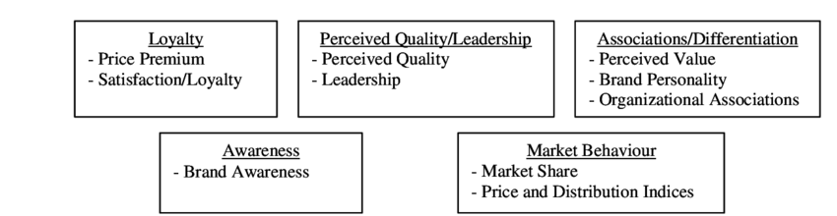
The Brand Equity Ten

Slide 11

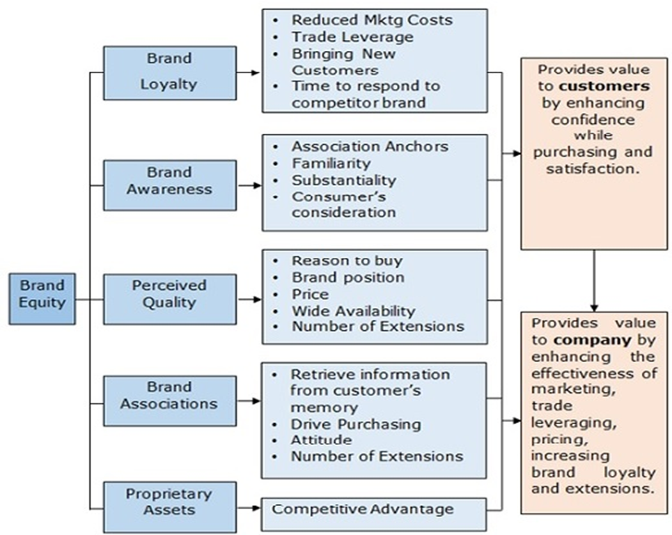
Cont..,

Slide 12
Types of Brand Extension
Product form
Companion product
Company expertise
Brand distinction
Brand prestige
Transfer of components
Leveraging a lifestyle

Slide 13



Slide 14



Slide 15



Slide 16



Slide 17

Principles for Building and Sustaining Brand Equity
Competitive differentiation
Brand consistency and image
Legally protect your brand and trademarks
Sustainability and longevity of the brand

Slide 18
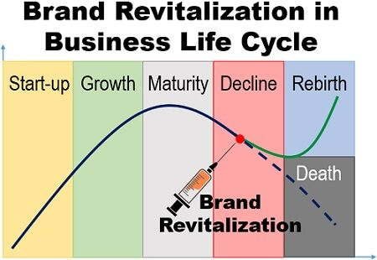
Brand Revitalization
The Brand Revitalization is the marketing strategy adopted when the product reaches the maturity stage of product life cycle, and profits have fallen drastically. It is an attempt to bring the product back in the market and secure the sources of equity i.e. customers.

Slide 19

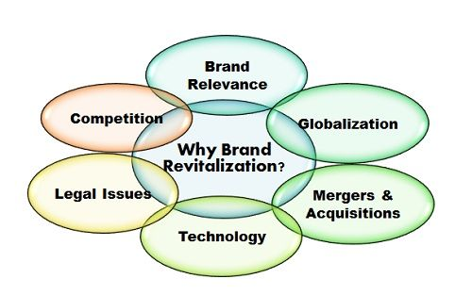


Slide 20

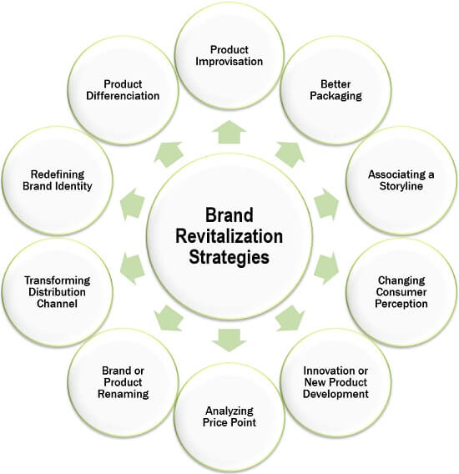
Brand Revitalization Strategy

Slide 21

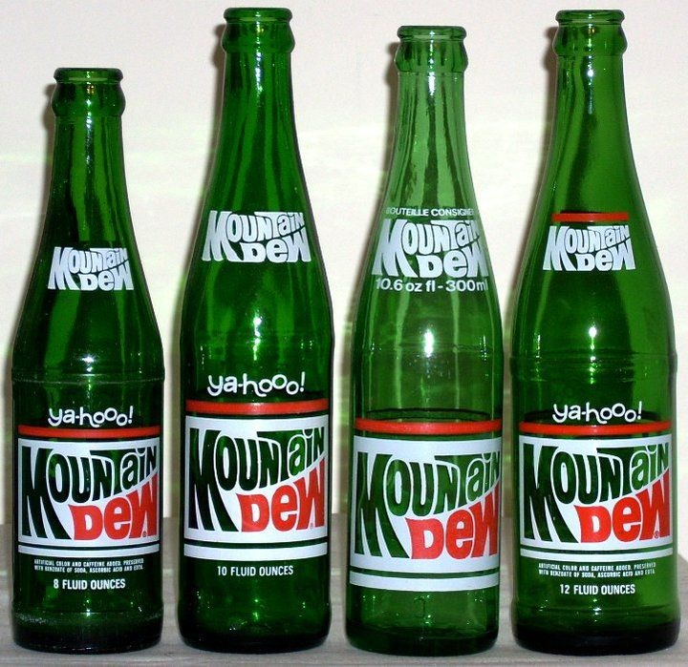


Slide 22




Slide 23

Brand Audit
A brand audit is a checkup that evaluates your brand's position in the marketplace, its strengths and weaknesses, and how to strengthen it.
Internal Branding
External Branding
Customer Experience

